Slide 1
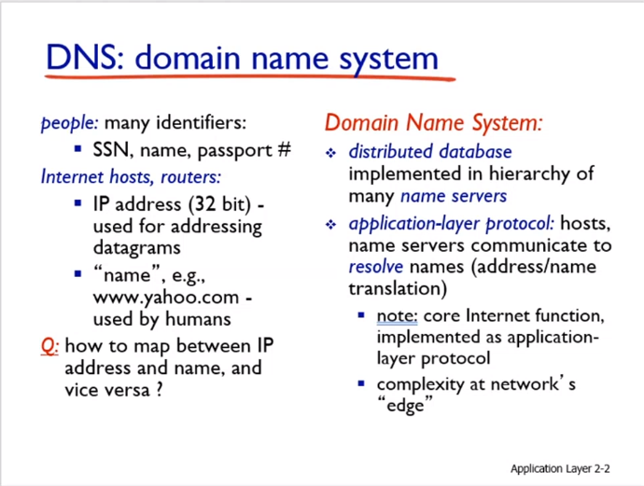
Application Layer
2-<number>

Slide 2
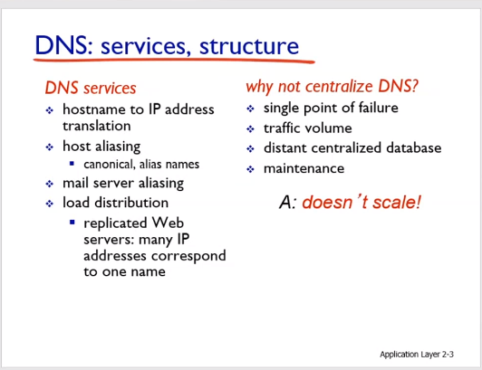
Application Layer
2-<number>

Slide 3
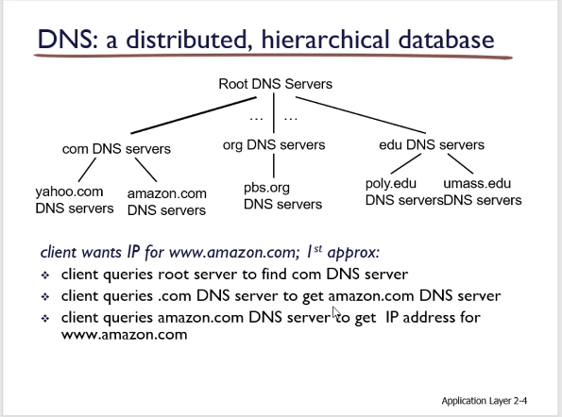
Application Layer
2-<number>

Slide 4
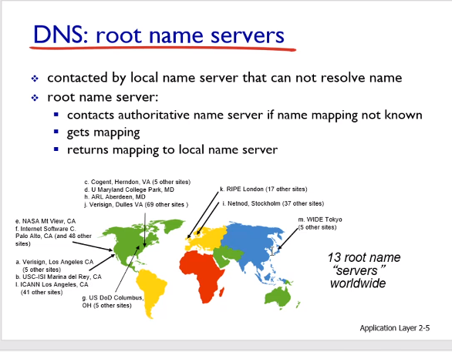

Slide 5
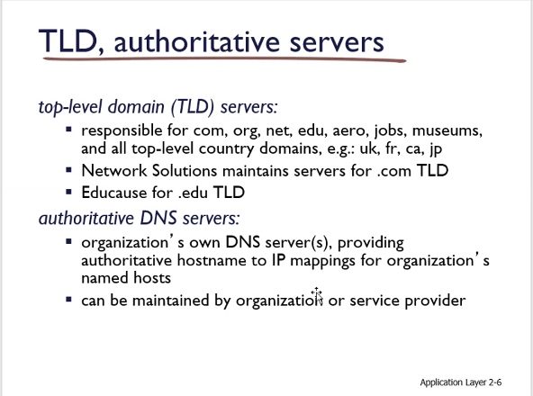

Slide 6
Local DNS name server
does not strictly belong to hierarchy
each ISP (residential ISP, company, university) has one
  also called “default name server”
when host makes DNS query, query is sent to its local DNS server
  has local cache of recent name-to-address translation pairs (but may be out of date!)
  acts as proxy, forwards query into hierarchy
Application Layer
2-<number>

Slide 7
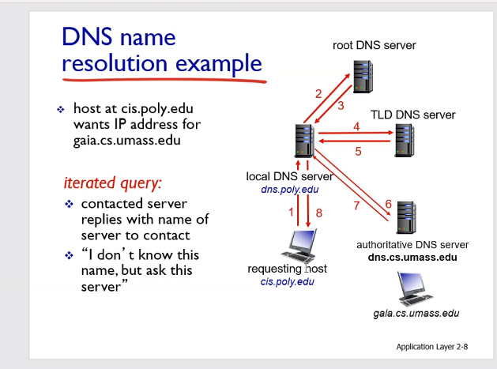
Application Layer
2-<number>

Slide 8
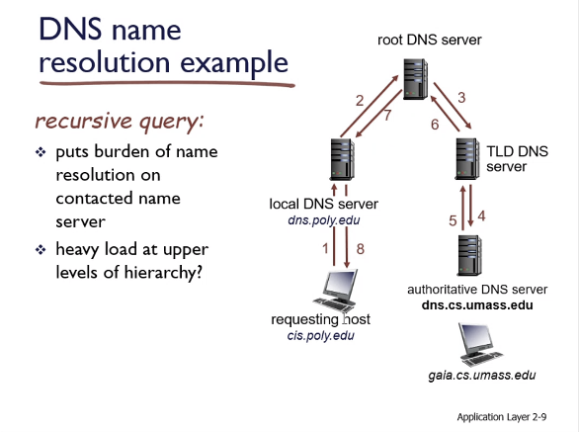
Application Layer
2-<number>

Slide 9
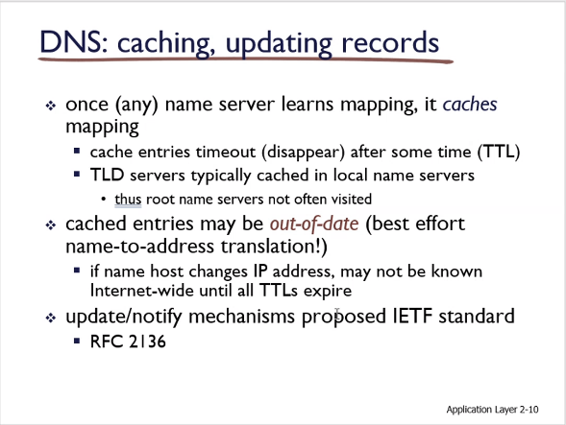
Application Layer
2-<number>

Slide 10
DNS records
DNS: distributed db storing resource records (RR)
RR format: (name, value, type, ttl)
type=A
  name is hostname
  value is IP address
type=CNAME
  name is alias name for some “canonical” (the real) name
  www.ibm.com is really
  servereast.backup2.ibm.com
  value is canonical name
type=NS
  name is domain (e.g., foo.com)
  value is hostname of authoritative name server for this domain
type=MX
  value is name of mailserver associated with name
Application Layer
2-<number>

Slide 11
DNS protocol, messages
query and reply messages, both with same message format
2 bytes
2 bytes
msg header
identification: 16 bit # for query, reply to query uses same #
flags:
  query or reply
  recursion desired
  recursion available
  reply is authoritative
identification
flags
# questions
# answer RRs
# authority RRs
# additional RRs
questions (variable # of questions)
answers (variable # of RRs)
authority (variable # of RRs)
additional info (variable # of RRs)
Application Layer
2-<number>

Slide 12
DNS protocol, messages
2 bytes
2 bytes
identification
flags
# questions
# answer RRs
# authority RRs
# additional RRs
name, type fields
for a query
questions (variable # of questions)
RRs in response
to query
answers (variable # of RRs)
records for
authoritative servers
authority (variable # of RRs)
additional “helpful”
info that may be used
additional info (variable # of RRs)
Application Layer
2-<number>

Slide 13
Attacking DNS
DDoS attacks
Bombard root servers with traffic
  Not 100 % successful to date
  Traffic Filtering
  Local DNS servers cache IPs of TLD servers, allowing root server bypass
Bombard TLD servers
  Potentially more dangerous
Redirect attacks
Man-in-middle
  Intercept queries
DNS poisoning
  Send bogus relies to DNS server, which caches
Exploit DNS for DDoS
Send queries with spoofed source address: target IP
Requires amplification
Application Layer
2-<number>

Slide 14
Definition
Since the 1980s, MitM attacks have been used to infiltrate traffic between innocent parties.
Man-in-the-Middle (MitM) attacks happen when traffic between two parties is observed or manipulated by an unknown third party.
A MitM attack is a cybercrime method used to steal personal information or login credentials. Cyber criminals also use MitM attacks as a means to spy on, corrupt information, or disrupt communications between two parties.
.
Notes:
References:
https://us.norton.com/internetsecurity-wifi-what-is-a-man-in-the-middle-attack.html
https://www.csoonline.com/article/3340117/what-is-a-man-in-the-middle-attack-how-mitm-attacks-work-and-how-to-prevent-them.html

Slide 15
Methods
Man-in-the-Middle attacks can happen in a number of ways:
Types of Spoofing (IP, DNS, HTTPS)
Hijacking (Secure Socket Layer, Email)
Wi-Fi Eavesdropping
Theft of Browsing Cookies
.
Notes:
References:
https://us.norton.com/internetsecurity-wifi-what-is-a-man-in-the-middle-attack.html
https://www.csoonline.com/article/3340117/what-is-a-man-in-the-middle-attack-how-mitm-attacks-work-and-how-to-prevent-them.html

Slide 16
Man-in-the-Browser:
Phishing is a method of sending fraudulent emails or text messages to trick a user into revealing personal information.
When a Man-in-the-Browser attack takes place, the attacker uses a Phishing method in order to administer malware to a device.
Malware is software meant to damage a network, server or personal computer.
Notes:
References:
https://us.norton.com/internetsecurity-wifi-what-is-a-man-in-the-middle-attack.html
https://www.csoonline.com/article/3340117/what-is-a-man-in-the-middle-attack-how-mitm-attacks-work-and-how-to-prevent-them.html

Slide 17
Man-in-the-Browser Continued
A Man-in-the-Browser attack happens when malware installs itself on a victim’s browser in order to record information sent between targeted websites and the user.
Online banking institutions are prone to this form of cybercrime.
Notes:
References:
https://us.norton.com/internetsecurity-wifi-what-is-a-man-in-the-middle-attack.html
https://www.csoonline.com/article/3340117/what-is-a-man-in-the-middle-attack-how-mitm-attacks-work-and-how-to-prevent-them.html

Slide 18
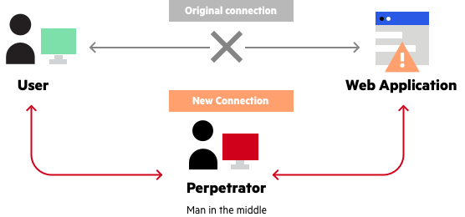
Example of Man-in-the-Browser
Notes:
References:
https://www.imperva.com/learn/application-security/man-in-the-middle-attack-mitm/

Slide 19
IP Spoofing
An IP Address is like your home address.
All devices that connect to the internet have an IP Address.
Spoofing happens when someone or something copies a trusted source.
Attackers use IP Spoofing in order to deceive users into revealing sensitive information by “spoofing” their IP and posing as a website or someone familiar.
.
Notes:
References:
https://us.norton.com/internetsecurity-wifi-what-is-a-man-in-the-middle-attack.html
https://www.csoonline.com/article/3340117/what-is-a-man-in-the-middle-attack-how-mitm-attacks-work-and-how-to-prevent-them.html

Slide 20
DNS Spoofing
Example: The DNS will return the IP address of a visited website when it is typed into a browser.
DNS refers to “Domain Name Server/System”. The DNS system converts names to IP Addresses.
When Spoofing a DNS, a user is forced to an imitation website, similar to the one intended to be viewed.
The goal of the attacker is to divert traffic or retrieve login credentials.
.
Notes:
References:
https://us.norton.com/internetsecurity-wifi-what-is-a-man-in-the-middle-attack.html
https://www.csoonline.com/article/3340117/what-is-a-man-in-the-middle-attack-how-mitm-attacks-work-and-how-to-prevent-them.html

Slide 21
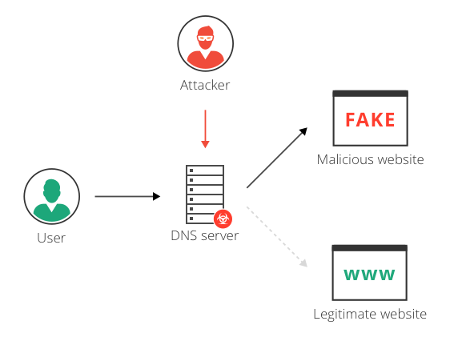
Example of DNS Spoofing
..
Notes:
References:
https://www.imperva.com/learn/application-security/dns-hijacking-redirection/

Slide 22
HTTPS Spoofing
HTTPS stands for Hypertext Transfer Protocol Secure. This protocol is used by the Web to format and transmit messages.
Ensure that when visiting a website, the URL indicates that it uses “https” rather than “http”.
..
Notes:
References:
https://us.norton.com/internetsecurity-wifi-what-is-a-man-in-the-middle-attack.html
https://www.csoonline.com/article/3340117/what-is-a-man-in-the-middle-attack-how-mitm-attacks-work-and-how-to-prevent-them.html

Slide 23
HTTPS Spoofing
In HTTPS Spoofing, the attacker manipulates the browser into believing it is visiting a trusted website.
After redirecting your browser, the attacker uses the vulnerable website to monitor communication and steal shared information.
.
Notes:
References:
https://us.norton.com/internetsecurity-wifi-what-is-a-man-in-the-middle-attack.html
https://www.csoonline.com/article/3340117/what-is-a-man-in-the-middle-attack-how-mitm-attacks-work-and-how-to-prevent-them.html

Slide 24
Protection
Ensure that the browser is using “https” when browsing the web.
Be on alert of Phishing emails that request credentials to be updated.
..
Notes:
References:
https://us.norton.com/internetsecurity-wifi-what-is-a-man-in-the-middle-attack.html
https://www.csoonline.com/article/3340117/what-is-a-man-in-the-middle-attack-how-mitm-attacks-work-and-how-to-prevent-them.html

